Slide 1
OUR PROBLEM STATEMENT IS:
Employee Attrition Analysis for Effective Workforce Management

Slide 2
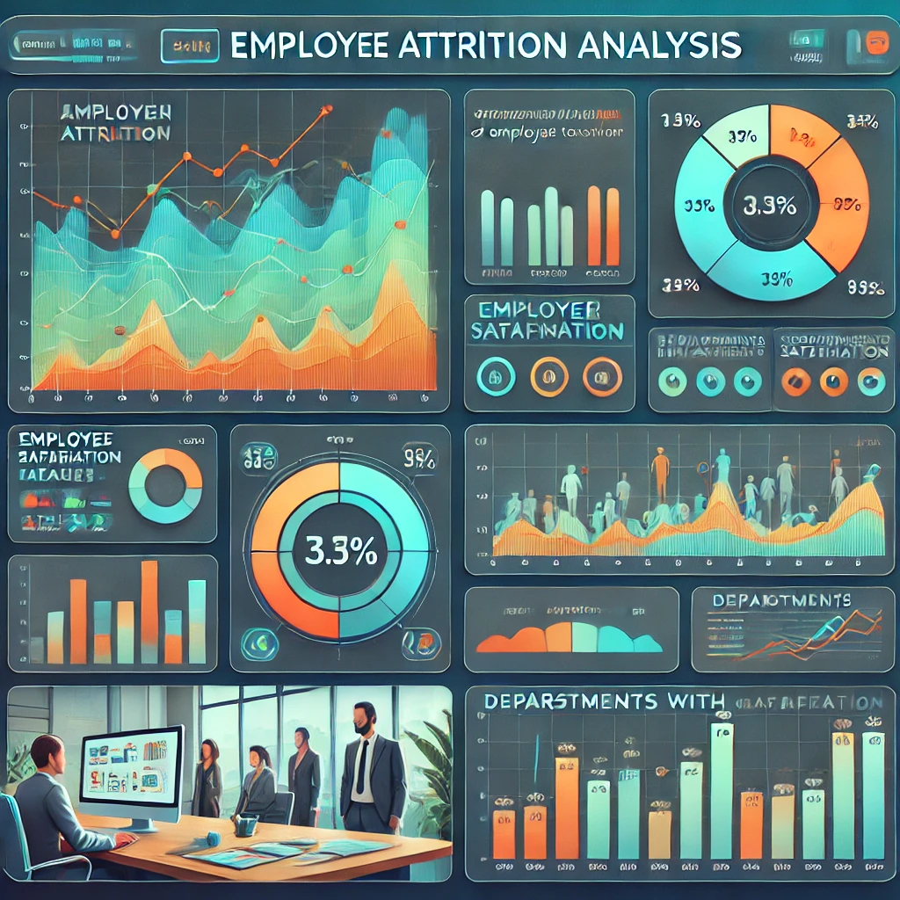
Introduction
Employee attrition analysis helps organizations identify why employees leave, detect patterns, and implement strategies to improve retention. It is key to reducing costs, enhancing employee satisfaction, and ensuring productivity.

Slide 3
Steps in Attrition Analysis
1. Define Objectives
2. Data Collection
3. Data Preparation
4. Analytical Methods
5. Insights and Interpretation
6. Actionable Strategies
7. Monitoring and Iteration

Slide 4
Data Collection and Preparation
Data Sources:
- Employee demographics, job roles, and performance
- Exit interviews and surveys
- Industry benchmarks
Data Preparation:
- Clean data and handle missing values
- Create relevant features (e.g., tenure categories)
- Segment data by department, role, or location

Slide 5
Analytical Methods
- Descriptive Analysis: Identify trends and visualize data
- Predictive Analysis: Use models to predict high-risk employees
- Text Analytics: Analyze feedback for recurring themes

Slide 6
Insights and Metrics
Key Metrics:
- Attrition Rate: (Employees Who Left / Average Employees) × 100
- Voluntary vs. Involuntary Turnover
Insights:
- High attrition in specific roles or departments
Correlation between job satisfaction and attrition
Machine Learning Techniques
- Random Forest and other models predict attrition probabilities.
- Dashboards display high-risk employees and attrition trends.

Slide 7
Actionable Strategies
- Improve work environment and recognition programs
- Offer career development and training opportunities
- Benchmark competitive compensation
- Conduct regular feedback sessions and act on insights
- Train leadership to better support employees

Slide 8
Monitoring and Iteration
1. Track retention rates post-strategy implementation
2. Regularly update analysis with new data
3. Refine policies based on feedback and results

Slide 9

Visualizations
- Dashboards and charts highlight key factors influencing turnover.
- Visualizations aid in identifying trends and high-risk areas.

Slide 10
Benefits
- Reduces attrition rates and enhances workforce stability.
- Supports data-driven HR strategies for organizational growth.

Slide 11
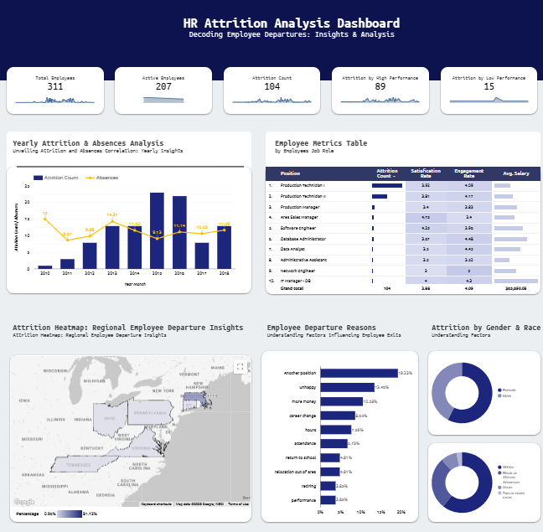
Overview of Dashboard

Slide 12
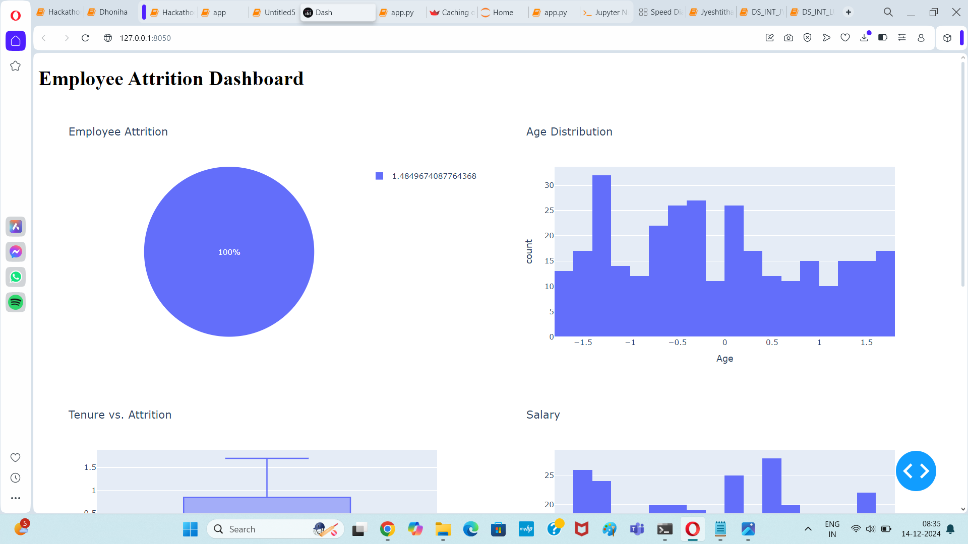
Employee Attrition Dashboard
import dash
from dash import dcc, html
import pandas as pd
import plotly.express as px
from dash.dependencies import Input, Output
# Load your data
dataset = pd.read_csv("C:\\Users\\HP\\Downloads\\large_employee_attrition_dataset.csv")
# Initialize the Dash app
app = dash.Dash(__name__)
# Layout of the dashboard
app.layout = html.Div([
html.H1("Employee Attrition Dashboard"),

Slide 13
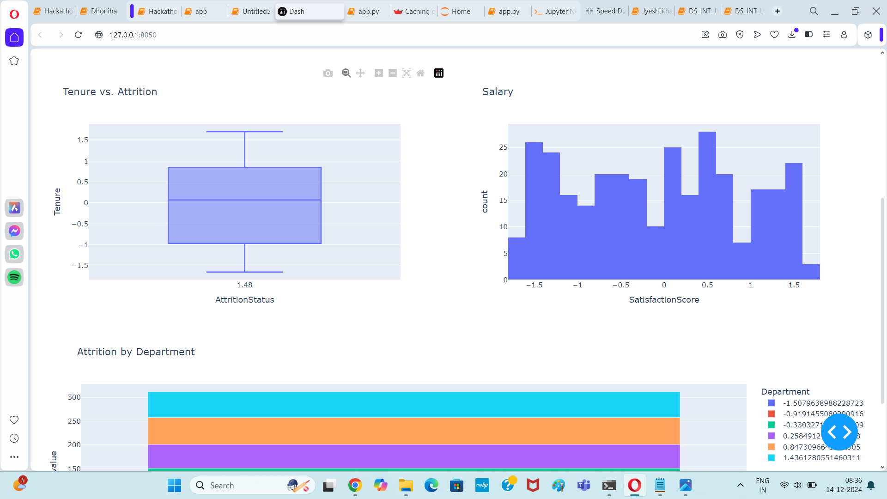
Boxplot, Barplot
# Age range slider
dcc.RangeSlider(
id='age-slider',
min=dataset['Age'].min(),
max=dataset['Age'].max(),
step=1,
marks={i: str(i) for i in range(int(dataset['Age'].min()), int(dataset['Age'].max()) + 1, 5)},
value=[25, 45]
),
# Graphs for attrition and other metrics
dcc.Graph(id='attrition-pie-chart'),
])

Slide 14
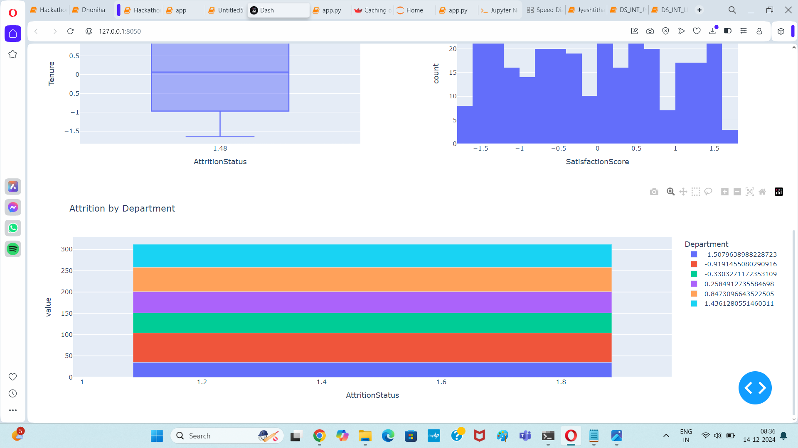
Attrition Status
@app.callback(
Output('attrition-pie-chart', 'figure'),
[Input('age-slider', 'value')]
)
def update_graph(age_range):
# Filter data based on the age range
filtered_dataset = dataset[(dataset['Age'] >= age_range[0]) & (dataset['Age'] <= age_range[1])]
attritionstatus_pie = px.pie(filtered_dataset, names='AttritionStatus', title='Employee Attrition')
return attritionstatus_pie
if __name__ == '__main__':
app.run_server(debug=True)

Slide 15
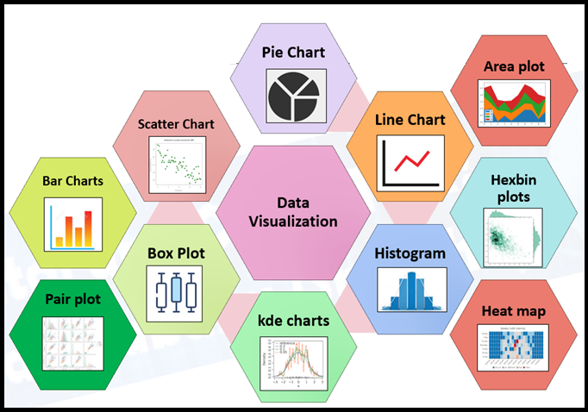
Data Visualisation techniques to overview our problem statement

Slide 16
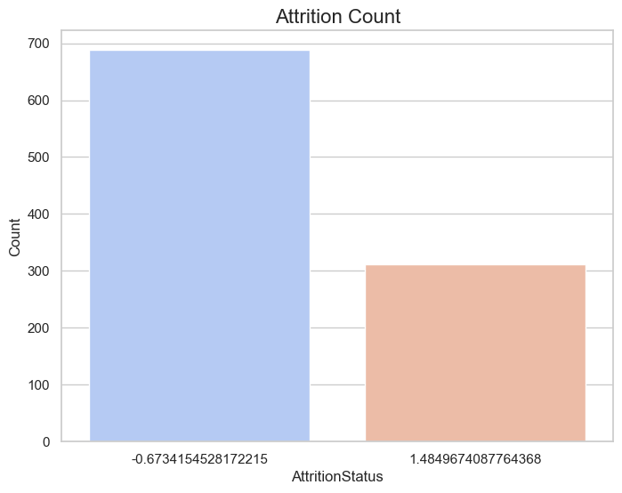
Attrition Count
# Set a style for the plots
sns.set(style="whitegrid")
# Visualization 1: Attrition Count
plt.figure(figsize=(8, 6))
sns.countplot(data=dataset,
x='AttritionStatus', palette='coolwarm')
plt.title('Attrition Count', fontsize=16)
plt.xlabel('AttritionStatus’, fontsize=12)
plt.ylabel('Count', fontsize=12)
plt.show()

Slide 17
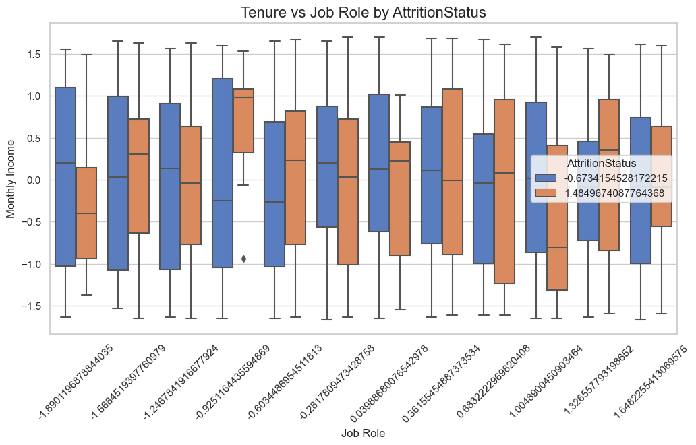
Tenure vs Job Role by Attrition Status
plt.figure(figsize=(12, 6))
sns.boxplot(data=dataset, x='JobRole', y='Tenure', hue='AttritionStatus', palette='muted')
plt.title('Tenure vs Job Role by AttritionStatus', fontsize=16)
plt.xlabel('Job Role', fontsize=12)
plt.ylabel('Monthly Income', fontsize=12)
plt.xticks(rotation=45)
plt.show()

